Slide 1
Migrant and Refugee Center: Demographic Collection for Strategic Outreach
Russell Cook
B.S. Biology | Joint Bachelor’s/M.D. Program
Notes:
Introduce yourself

Slide 2
Arts and Sciences Dean’s Task Force on Immigrants and Refugees
Inspired by Pope Francis’s four pillars:
Welcome
Protect
Promote
Integrate
New Jersey overall has the fifth largest immigrant population in the U.S.
Over two million immigrants
500,000 of whom are undocumented
Four counties that comprise the Archdiocese (Bergen, Union, Essex and Hudson)
Substantial growth in their immigrant communities
Program development for legal, healthcare, education
Notes:
Shoutout to the Provost Office
Undergraduate research grant from Provost Office to task force (THANK YOU)
Shoutout to Mr. Hoffman and Dr. Mirabella
Legal, education (mine is one education), health issues (collab between SHU and Archdiocese)
Which towns from the four counties have the most need for english-language learning and education for career advancement

Slide 3
Methodology
Goal: Illuminate the education profile of the migrant and refugee populations in the Archdiocese of Newark
Charge: Collect, analyze, and interpret demographic and statistical data
Six key demographic criteria:
Graduation Rate
Free or Reduced Lunch
Student Populations: English Language Learners
Student Populations: Students in Poverty
Percent of People in Poverty by Town
Percent of Non-English Speaking Population
Created a metric of educational need across towns and counties
Higher scores indicate towns that were cited more often as places for target outreach
(Rank #1 = 3 points; Rank #2 = 2 points; Rank #3 = 1 point)
Notes:
My goal is step 1 of a 3-step plan
1. Compiled most recent U.S. Census data from SHU Policymap database into Excel spreadsheet
2. Converted data into more accessible and readable tables and graphs
3. Compiled tables, graphs, and descriptive analysis for the following areas researched into comprehensive document:
Graduation Rate
Free or Reduced Lunch
Student Populations: English Language Learners
Student Populations: Students in Poverty
Household income report by county
Percent of people in poverty by town
Percent of Non-English Speaking Population
Predominant Language Spoken at Home
Including English
Excluding English
Excluding Spanish or Spanish Creole
Predominant County of Birth Among Foreign-Born Population
Percentage of Green Card Recipients by Each Region of Immigration
4. Summarized bolded criteria above to complete cross-tabulations
5. Used cross-tabulations to highlight diverse profile of each potential target area for future outreach

Slide 4
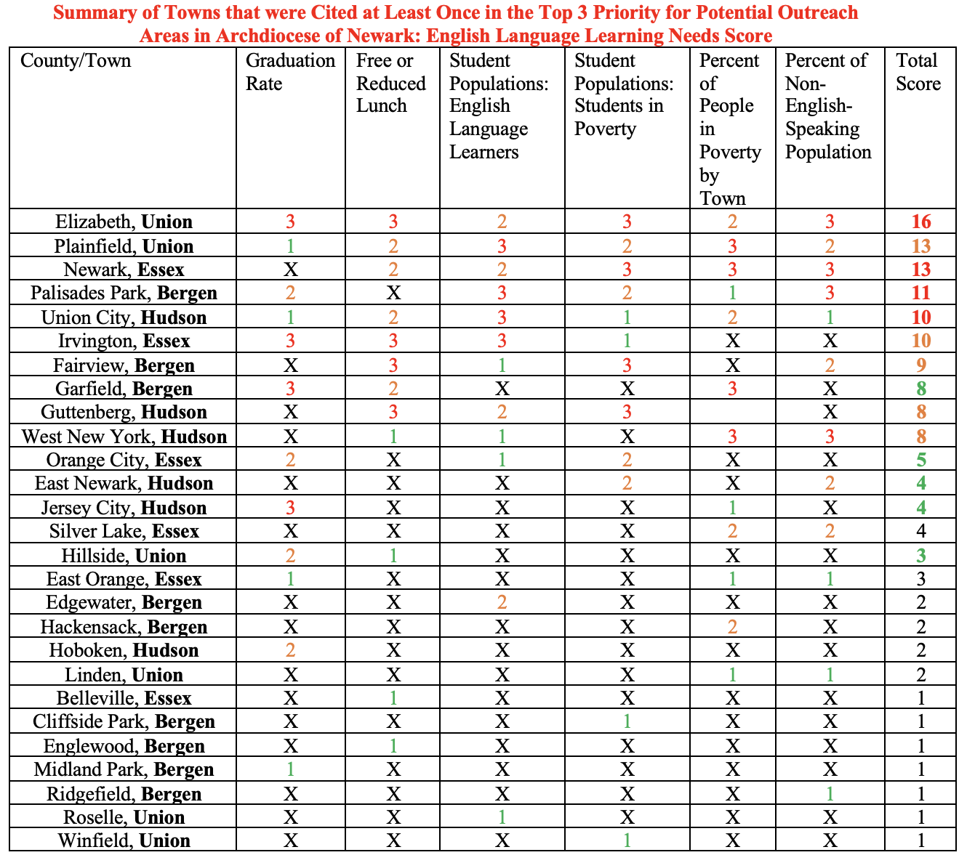
(Rank #1 = 3 points; Rank #2 = 2 points; Rank #3 = 1 point)
Notes:
Note: X means that town did rank in top 3 for that criterion in its specific county
This chart compiles the information from the six key criteria used and the ranking system for educational need in each town and across county
Give 1 example or 2 (e.g. Elizabeth has ranked #1 in all criteria except Student Pop: english lang learners and percent of people in poverty by town)
Give people a key for how to read chart
Do this per county

Slide 5
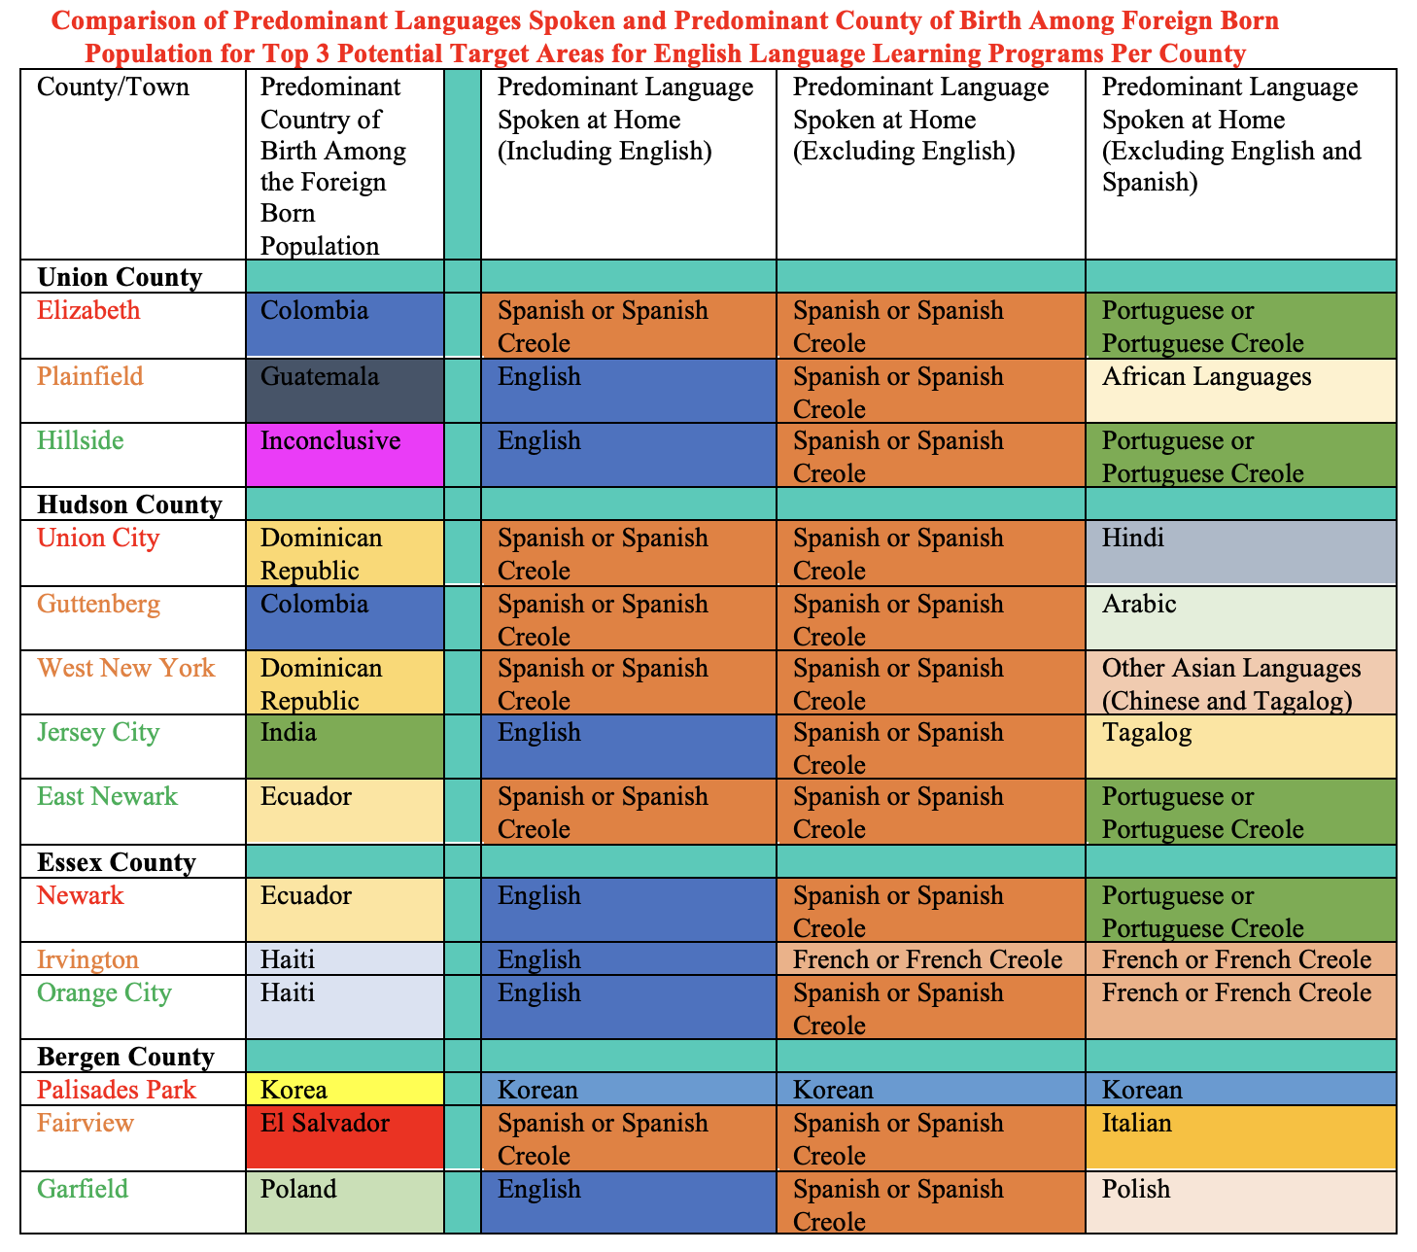
Notes:
Using U.S. Census data
Compiled information for towns with highest need
Highlights the languages spoken at home and the country of origin
(e.g. Elizabeth Colombia, even when including English, Spanish or Spanish Creole is still predominant, then the exclusion of Spanish or Spanish Creole helps identify Portuguese or Portuguese Creole)
Remember to tell them the colors (English blue, Spanish or Spanish Creole Orange)
Outliers
Jersey City
India vs span and tagalog
Korea
Predominant across every portion

Slide 6
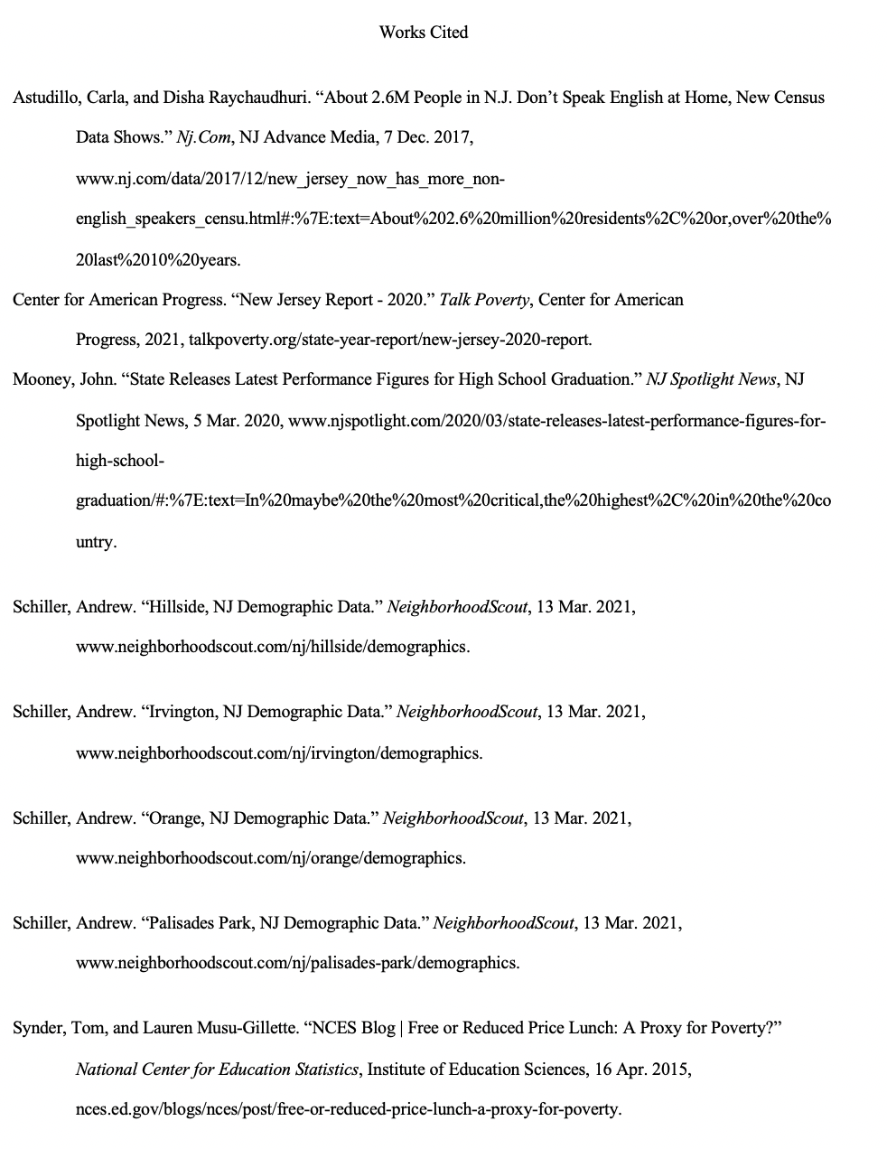
Resources Used
Powered using U.S. Census Data
Notes:
I used Policy Map database that holds demographic data found in Seton Hall University library database
Other sources I used to further my research
U.S. Census Bureau website to fill in holes for data from Policy Map for such places like Union City, Irvington, and Hillside, since they scored high on the criteria and would be important to know about what languages people speak in that area/where the majority of immigrants come from in those areas

Slide 7
Questions?
Notes:
-Call for questions and thank everyone for listening!

