Slide 1
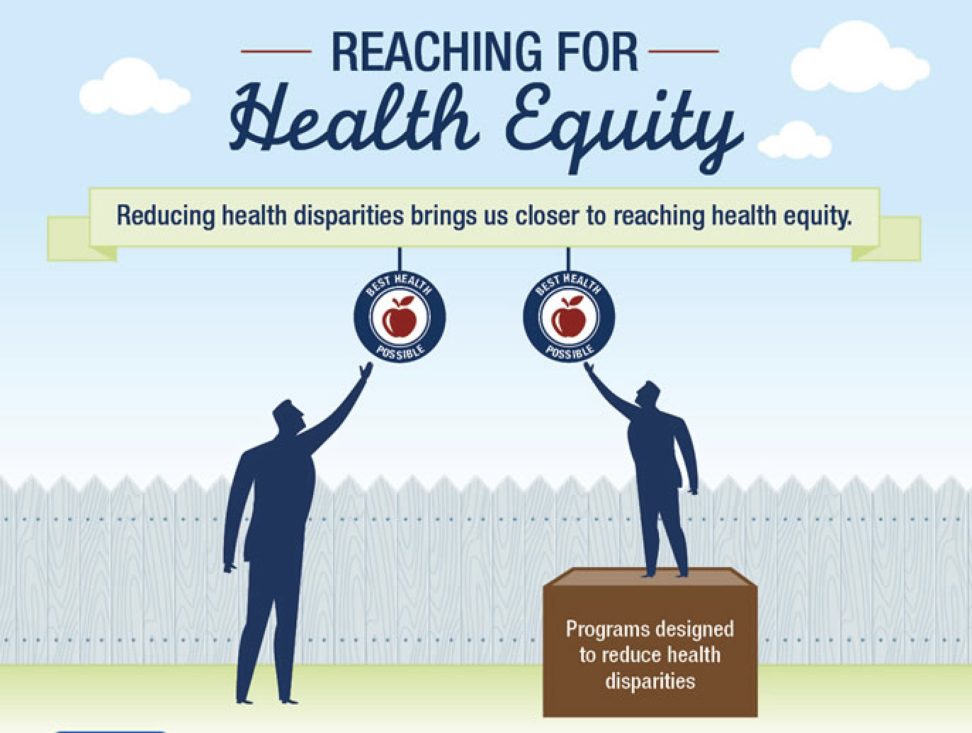
Migrant and Refugee Center: Health Demographic Collection for Strategic Outreach
Russell Cook
B.S. Biology | Joint Bachelor’s/M.D. Program

Slide 2



Arts and Sciences Dean’s Task Force on Immigrants and Refugees
Inspired by Pope Francis’s four pillars:
  Welcome
  Protect
  Promote
  Integrate
New Jersey overall has the fifth largest immigrant population in the U.S.
  Over two million immigrants
    500,000 of whom are undocumented
Four counties that comprise the Archdiocese (Union, Hudson, Essex, and Bergen)
  Substantial growth in their immigrant communities
Program development for legal, healthcare, education
Notes:
Shoutout to Mr. Hoffman and Dr. Mirabella for their support and guidance in my research with this project
Legal, education, health issues (mine is one health this time, I gave presentation education last year) → (collab between SHU and Archdiocese)
My research on the migrant and refugee background within the Archdiocese of Newark has informed my work on this project venturing into health disparities and risk factors certain areas experience
Which towns from the four counties have the most need for health outreach programs to bridge gaps, especially in medically underserved areas

Slide 3
Methodology Part 1
Goal: Illuminate access to healthcare and health disparities amongst the migrant and refugee populations in the Archdiocese of Newark
Charge: Collect, analyze, and interpret demographic and statistical data
13 key demographic criteria included with 4 criteria excluded:
  Access to Healthcare Criteria
Estimated percent of all people without health insurance, between 2015-2019 | Estimated percent of people with Medicare, between 2015-2019. | Estimated percent of people with Medicaid, between 2015-2019 | Medically Underserved Areas (MUA), as of 2020. | Primary Care Health Professional Shortage Area status as of 2021.
Mental Health Professional Shortage Area status as of 2021. | Dental Health Professional Shortage Area status as of 2021. | Estimated percent of adults reporting to have a personal doctor or health care provider in 2018. | Estimated percent of adults reporting a physical checkup in the past year in 2018.
Notes:
My goal is step 1 of a 3-step plan
1. Compiled most recent U.S. Census data from SHU Policymap database into Excel spreadsheet
2. Converted data into more accessible and readable tables and graphs
3. Compiled tables, graphs, and descriptive analysis for the following areas researched into comprehensive document:
4. Summarized bolded criteria above to complete cross-tabulations
5. Used cross-tabulations to highlight diverse profile of each potential target area for future outreach
Criteria excluded for limited data sets, or poor correlations and outliers like Alpine
Blue is included
Red is excluded

Slide 4
Methodology (Part 2)
13 key demographic criteria with 4 Criteria Excluded:
  Health Disparity and Comorbidities Criteria
Created a metric of educational need across towns and counties
  Higher scores indicate towns that were cited more often as places for target outreach
    (Rank #1 = 3 points; Rank #2 = 2 points; Rank #3 = 1 point)
    Score Multiplier: (High Priority = 1.5x Base Score; Medium Priority = 1x Base Score; Low Priority = 0.5x Score)
Estimated percent of adults reporting to be obese (a body mass index of 30 or greater) in 2018. | Estimated percent of adults reporting to engage in heavy drinking in 2018. | Estimated percent of adults reporting to engage in binge drinking in 2018. | Estimated percent of adults reporting to have ever smoked cigarettes in 2018.
Estimated percent of adults ever diagnosed with diabetes mellitus in 2018. | Estimated percent of adults ever diagnosed with heart disease or a heart attack in 2018. | Estimated percent of adults ever diagnosed with high blood pressure (hypertension) in 2017 | Estimated percent of adults ever diagnosed with high cholesterol in 2017.
Notes:
My goal is step 1 of a 3-step plan
1. Compiled most recent U.S. Census data from SHU Policymap database into Excel spreadsheet
2. Converted data into more accessible and readable tables and graphs
3. Compiled tables, graphs, and descriptive analysis for the following areas researched into comprehensive document:
4. Summarized bolded criteria above to complete cross-tabulations
5. Used cross-tabulations to highlight diverse profile of each potential target area for future outreach
Blue shows all included
Define Health Disparity: Health disparities are inequitable and are directly related to the historical and current unequal distribution of social, political, economic, and environmental resources.

Slide 5
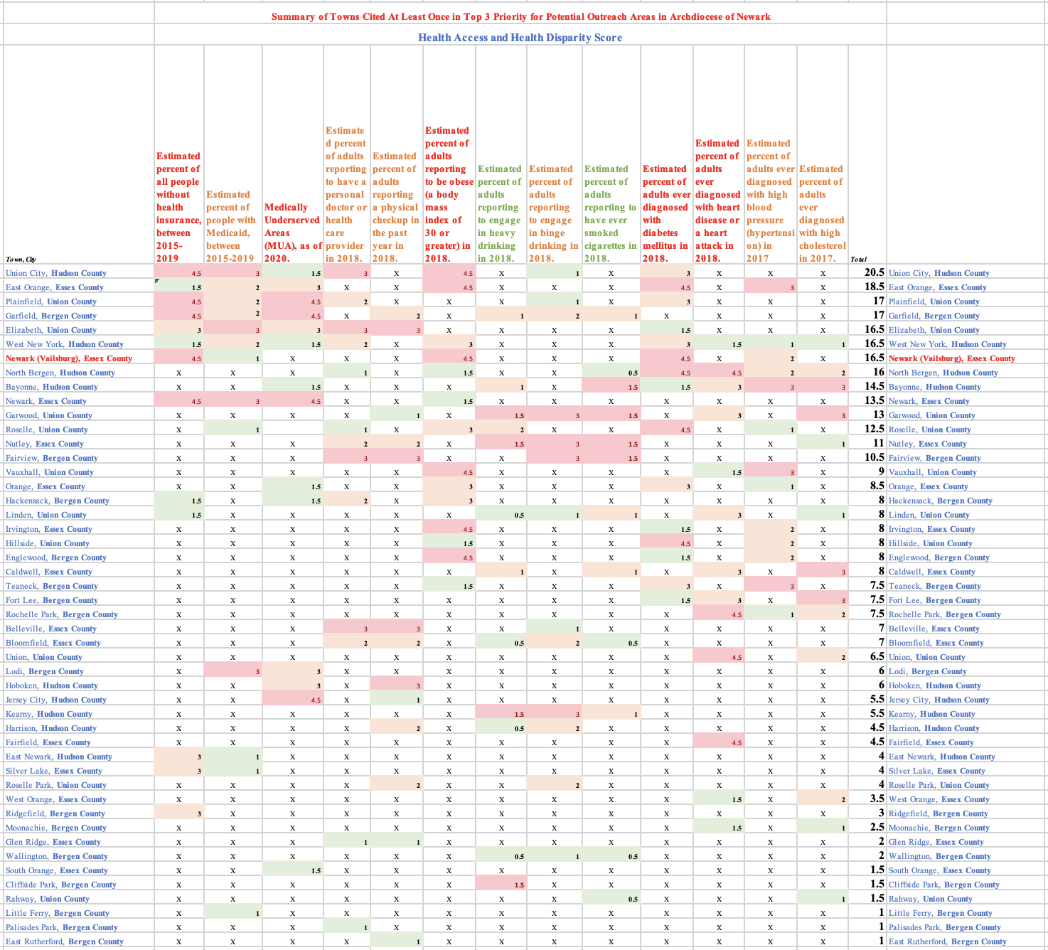
Score Multiplier: (High Priority = 1.5x Base Score; Medium Priority = 1x Base Score; Low Priority = 0.5x Score)
Base Score: (Rank #1 = 3 points; Rank #2 = 2 points; Rank #3 = 1 point)
Notes:
SHOW FULL TABLE (Mention Alpine excluded to extremely high SES and it only making its way into the comorbidities category suggests it is a lifestyle vs lack of proper health resources and lack of access to resources problem
Health: Costs and Insurance
Estimated percent of people with Medicare, between 2015-2019
Reason: Age alone can be a confounding variable in distinguishes at-risk populations
Primary Care Health Professional Shortage Area status as of 2021.
Mental Health Professional Shortage Area status as of 2021.
Dental Health Professional Shortage Area status as of 2021.
Overweight
Estimated percent of adults reporting to be overweight (a body mass index greater than 24.9) in 2018
Note: X means that town did rank in top 3 for that criterion in its specific county
This chart compiles the information from the six key criteria used and the ranking system for educational need in each town and across county
Give 1 example or 2
Give people a key for how to read chart
Do this per county
Mention Vailsburg community ranked higher than Newark overall, indicating outreach would make sense in this community which Dr. Mirabella serves

Slide 6
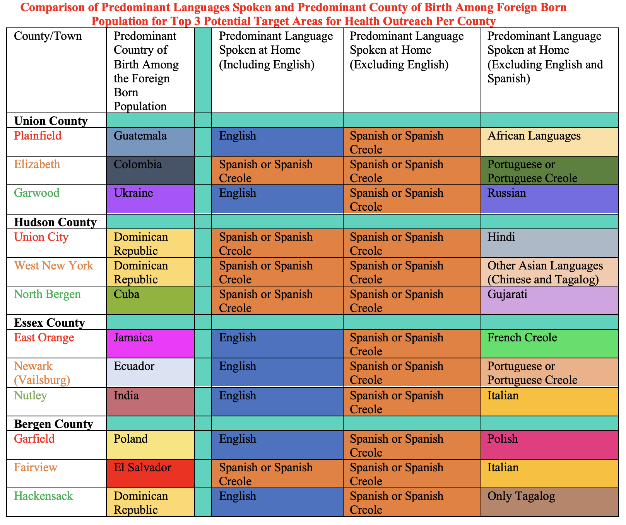
Notes:
SWAP PLAINFIELD AND ELIZABETH LANGUAGES and CONTACT Ms. DeLuca with update PPT
Show top 3 per county and the demographics
Using U.S. Census data
Compiled information for towns with highest need
Highlights the languages spoken at home and the country of origin
(e.g. Elizabeth Colombia, even when including English, Spanish or Spanish Creole is still predominant, then the exclusion of Spanish or Spanish Creole helps identify Portuguese or Portuguese Creole)
Remember to tell them the colors (English blue, Spanish or Spanish Creole Orange)
Creole is a mix of native and new languages like Haitain creole with a French base and new terms unique to culture/area
Outliers
All outliers were screened for having disproportionality in their SES which could be a confounding variable to the demonstrated need, access, and source of illness under social epidemiological lens
Towns such as Alpine were therefore screened out alongside others with median household income over 100,000 dollars to allow for identifying areas that are middle and lower class primarily for best outlook on potential outreach and providing resources to communities that most benefit from it

Slide 7

Resources Used
Powered Using U.S. Census Data
Notes:
I used Policy Map database that holds demographic data found in Seton Hall University library database
As a sanctuary state, New Jersey is focused on protecting the safety and privacy of its migrant and refugees protection
The U.S. Census data helps provide a robust and reliable measure of the current migrant/refugee demographics currently in New Jersey as it collects data from all residents and that includes foreign-born residents
There always is the limitation for a survey to miss certain target populations but using Department of Homeland Security (DHS) Office of Immigration Statistics uses a combination of administrative data to provide further estimates of the unauthorized immigrant population in the United States when needed
Number of persons obtaining legal permanent resident status and seeking asylum
Naturalizations
Nonimmigrant admissions
Enforcement actions
Other sources I used to further my research
U.S. Census Bureau website to fill in holes for data from Policy Map for such places like ______, since they scored high on the criteria and would be important to know about what languages people speak in that area/where the majority of immigrants come from in those areas
Maps of each county to locate the census tracts for the Vailsburg community of Newark to flesh out how this specific community matched up with the needs of other towns included in high priority category

Slide 8
Thank you for listening!
Any questions?
You can find me at:
russell.cook@student.shu.edu
Notes:
-Call for questions and thank everyone for listening!

